Slide 1

C379 Emerging technologIES
Lesson 15: Introduction to Machine Learning

Slide 2

L15 Learning Objectives
Understand the fundamental concepts of machine learning, including supervised, unsupervised, and reinforcement learning.
Explain the difference between classification, regression, and clustering problems.
Understand the workflow of Machine Learning
Identify the challenges and limitations of AI

Slide 3



Machine Learning

Slide 4
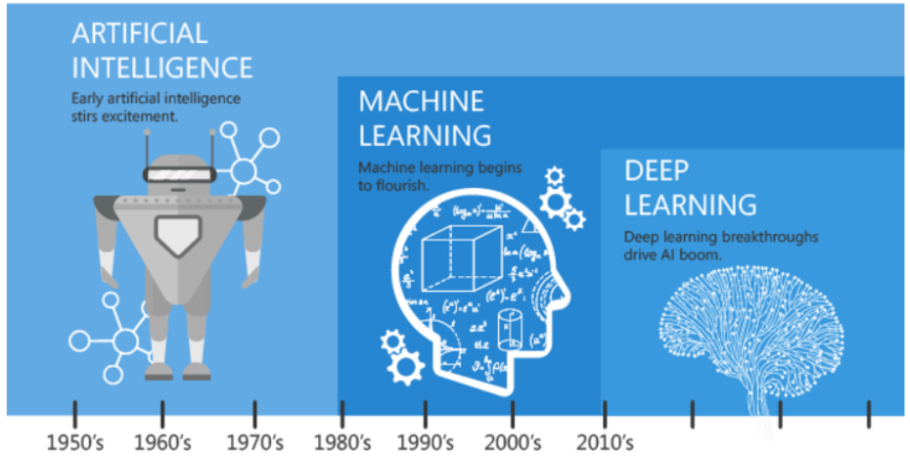
Machine Learning
AI describes the broad approach of using machines to imitate intelligent human behavior to solve problems.
Machine Learning (ML) is a technology used to achieve AI.
If one will to develop an algorithm to detect fraud in financial data, this would be typical AI.
If this algorithm still learns itself and also recognizes new facts, it would be called ML.

Slide 5
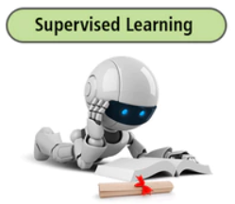
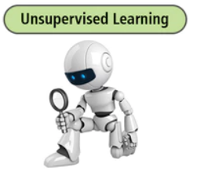
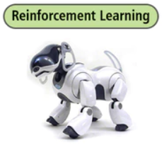
Types of MACHINE LEARNING
Machine Learning (ML) is a component of AI
It is the ability for an algorithm to learn from prior data in order to produce a desired behaviour.
It teaches machines to make decisions in situations they have never seen.
The mainstream approach to ML is showing the algorithm a data set of situations and telling it what the right decision is, through training a model.
Once the model has been trained, you can feed new data through the algorithm. Hopefully, the machine could make intelligent decisions from these new situations.

Slide 6
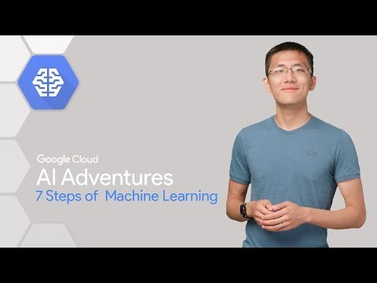
How Machine Learning works?
https://www.google.com/search?q=Ai+adventure+7+steps&rlz=1C1GCEU_enSG925SG925&oq=Ai+adventure+7+steps&aqs=chrome..69i57.12777j0j4&sourceid=chrome&ie=UTF-8#kpvalbx=_yBiSYarpGZvb9QPot6HYCg33

Slide 7

Team Discussion
Discuss within your team what type of machine learning is best/suitable for your assigned C379 project?
Supervised Learning
Unsupervised Learning
Reinforcement Learning
Why do you think so?

Slide 8
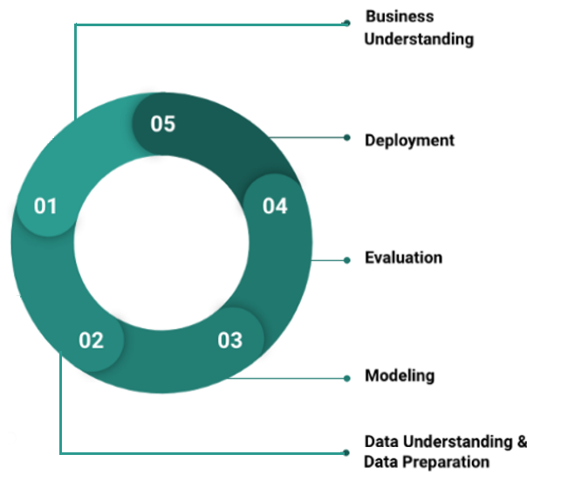
Workflow of Machine Learning
The predictive analytics process is as follows:
Problem understanding and definition
Data collection, preparation and understanding
Model building
Model evaluation
Model deployment

Slide 9

Tools
Programming Languages
Python, R, C#, SQL, etc.
Services
Google, AWS and Azure. Often used services are e.g. image and video recognition, translation, NLP and many more.
Software
Anaconda, Jupyter Notebook, R Studio, Tableau, etc.

Slide 10
Challenges & Limitations to AI
Data
Since data is sourced from diverse sources, it is unstructured and requires technological processes and significant human effort to cleanse it.
Increases Human Effort
Not only cleansing data, but also labeling it with the appropriate parameters so that machines can learn correctly, involve significant human effort.
Lacks Emotions
Unlike humans, machines lack emotional intelligence and cannot comprehend the feelings behind the spoken words/sentences.
Requires Supervision
Machines can only do what they are programmed or ‘trained’ to do. They can crunch data in real-time, but they cannot make judgments that require empathy. Similarly machines lack original thinking and creativity.
High Costs
AI is a costly technology and requires significant investments to set up the infrastructure. The software needs regular updates and maintenance to adapt to the changing business dynamics.
Notes:
Reference: https://www.dqindia.com/practical-limitations-artificial-intelligence-faces/

Slide 11
Team Discussion
Discuss within your team which challenges/limitations will likely to impact your C379 project (e.g. Washing Cycle Prediction)?
Why do you think so?

Slide 12




Toolkits Required for Predictive Modeling
Jupyter notebooks: interactive coding and visualization of output
NumPy, SciPy, Pandas: numerical computation
Matplotlib: data visualization
Scikit-learn: machine learning

Slide 13
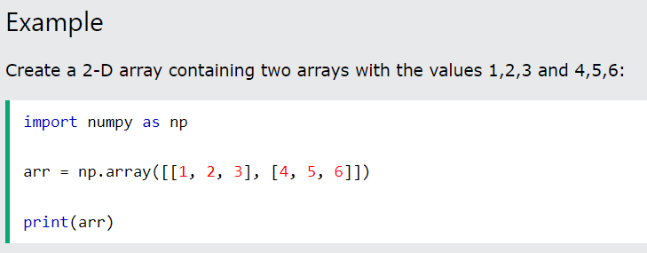

Introduction to NumPy
NumPy stands for Numerical Python
It is a Python library used for working with arrays (lists)
It also has functions for working in domain of linear algebra, Fourier transform, and matrices.

Slide 14
Introduction to Pandas
Library for computation with tabular data
Mixed types of data allowed in a single table
Columns and rows of data can be named
Advanced data aggregation and statistical functions
Source: http://pandas.pydata.org/

Slide 15

Introduction to Pandas
Basic data structures
Type
Pandas Name
Vector
(1 Dimension)
Series
Array
(2 Dimensions)
DataFrame

Slide 16
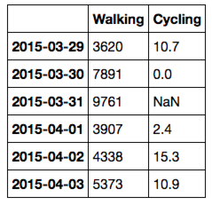
Introduction to Pandas
Pandas DataFrame Creation and Methods
Labeled columns and an index can be added
Code
Output
# Add column names to dataframe
activity_df = pd.DataFrame(joined_data,
index=pd.date_range('20150329’, periods=6),
columns=['Walking','Cycling'])
print(activity_df)
>>>

Slide 17
Data Visualisation
Matplotlib is the main library to create plots and graphs.
It has a lot of features and tweaks

Slide 18
Data Visualisation
Basic Scatter Plots with Matplotlib
Multiple layers of data can also be added
Code
Output
plt.plot(data.sepal_length, data.sepal_width,
ls ='', marker='o',
label='sepal')
plt.plot(data.petal_length,
data.petal_width,
ls ='', marker='o',
label='petal’)
plt.legend()

Slide 19
Google CoLab
Google Colab, short for Colaboratory, is a free cloud-based platform provided by Google that allows users to write and execute Python code collaboratively in a Jupyter Notebook environment.
Google Collaboratory notebook, is designed to facilitate machine learning (ML) and data science tasks by providing a virtual environment, Google colab python with access to free GPU resources.

Slide 20

CoLab Tutorial
https://www.youtube.com/watch?v=g0xu9DA4gDw
Duration: 12:33

Slide 21

Getting you Familiar with A Data Science Stack
Lab 15-1
Complete the lab materials for NumPy & Matplotlib

